Slide 1
Anatomy of the coronary arteries & Angiographic VISUALIZATION

Slide 2
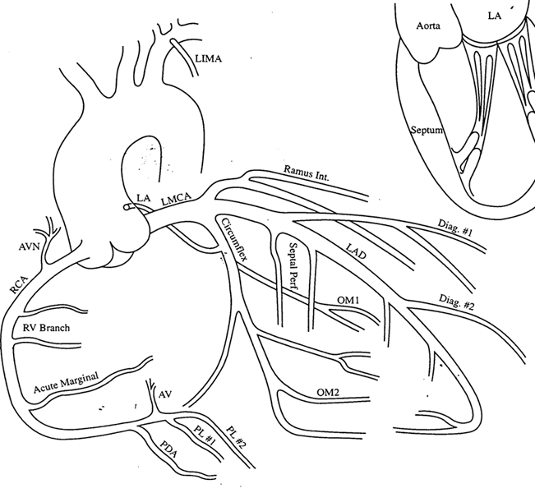
Coronary arterial anatomy
1st anatomical drawings- Leonardo da Vinci
Oblique inverted crown

Slide 3
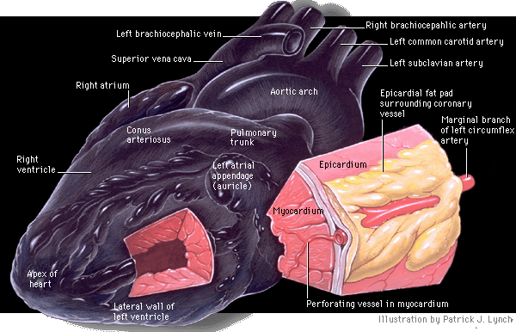
The coronary arteries and their major branches are sub-epicardially located

Slide 4
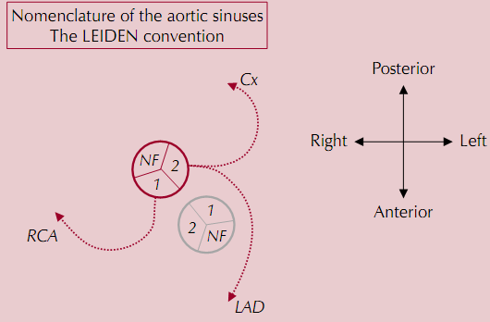
The LEIDEN convention
Each artery arises from respective aortic sinuses
- Right coronary sinus(anterior)
- Left coronary sinus(left posterior)
- Non-coronary sinus(right posterior)
1R2LCx pattern

Slide 5
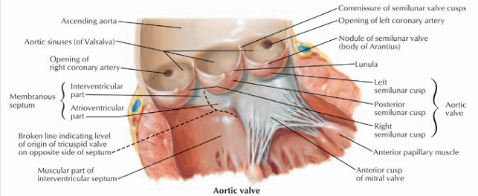
LCA ostium -4.7mm(Range 1.0 -8.5)
RCA ostium-3.7mm(Range 0.5 -7.0)
RCA takes off at right angle and LCA takes off at more acute angles

Slide 7
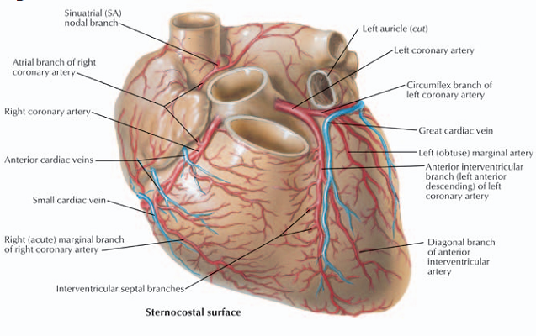

Slide 9
Right coronary artery
Arises from the right sinus of valsalva ,lies inbetween pulmonary conus and right atrium.
Moves sharply towards left of the observer and is directed towards sternum.
Curves down following right AV groove in direction of acute margin of heart and diaphragm.
Curves posteriorly and follows AV groove towards crux cordis.

Slide 10
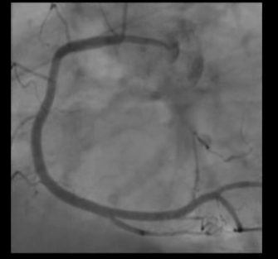
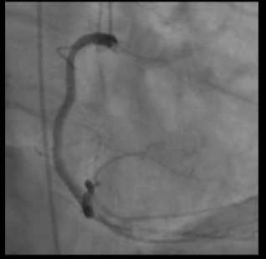
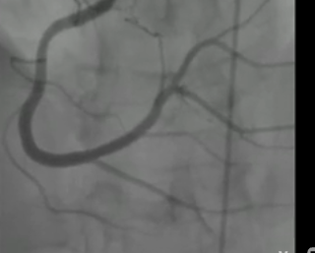
Right Coronary Artery
Proximal RCA
Proximal RCA
Mid RCA
Mid RCA
Distal RCA
PDA
Mid RCA
Distal RCA
PDA
PDA/PLV
LAO cranial
RAO cranial
PA Cranial
Best for visualization of ostial and proximal RCA
Best for visualization of mid RCA and PDA
Best for visualization of distal RCA and its bifurcation

Slide 11
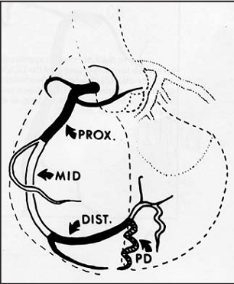
Surgical division of the RCA
Proximal - Ostium to 1st main RV branch
Mid - 1st RV branch to acute marginal branch
Distal - acute margin to the crux

Slide 12
Right coronary artery-branches
1)Conus artery/ Infundibular/ Third coronary/ Adipose /Arteria of Vieussens(1st branch in 60% cases)
Separate ostium in 23% - 51%
Curves away from main artery and proceeds ventrally encircling the outflow tract of RV at the level of pulmonary valve.

Slide 14
Right coronary artery-branches…
2)SA nodal artery arises from– RCA-55-65%,LCX -35-45%
Runs in opposite direction to the conus branch
Runs cranially,dorsally and to the right
Divides into two rami,one recurrent branch which supplies the SA node, the other runs posteriorly a left atrial branch.
Two divisions form a wide Y acquiring shape of ram’s horn.

Slide 15
Ram’s horn

Slide 16
Left horn-encircles the SVC and supplies the SA node.
Right horn-provides blood supply to superior and posterior walls of left atrium.
When SA nodal a. arises from LCX it arises from proximal portion then ascends to the right beneath the left atrial appendage and behind the aorta crossing the posterior aspect of the LA to reach the IAS and the SVC.

Slide 17
Right coronary artery-branches…
3) Right ventricular branches
one or more ventricular branches arising in the AV groove.
Often reach interventricular sulcus and anastomose with branches of LAD when occluded.

Slide 18
Right coronary artery-branches…
4) Right atrial artery-
-originates at about the level of acute marginal artery travels in opposite direction towards right heart border
-receives branches from SA nodal artery and bypasses obstruction in proximal portion of the RCA.

Slide 19
Right coronary artery-branches…
5) Acute marginal artery
-relatively large and constant vessel
-arises at lower aspect of right atrium just before or at the acute margin of the heart.

Slide 20
Right coronary artery-branches…
6) AV nodal artery(80%)
-slender ,straight vessel
-appears almost vertical in LAO view
-directed towards centre of heart shadow
-it arises from RCA where it forms a characteristic inverted U curve as the artery passes in the interventricular sulcus around the interventricular vein.

Slide 21
RCA-branches….
7) Posterior descending artery
-The PDA courses in the inferior interventricular groove gives rise to a number of small inferior septal branches which supply lower part of IVS and interdigitate with superior septal branches from LAD.
8) Posterolateral branches
-After giving rise to PDA ,the RCA continues beyond the crux cordis as the right posterior AV branch terminating in one or several posterolateral branches to supply the diaphragmatic surface of the LV.

Slide 22
At times the posterlateral branches may be larger than the PDA itself.
The entire sweep of RCA resembles a sickle,the blade formed by main stem of RCA and handle formed by PDA and posterior LV branches.

Slide 23
“Dominance”
giving rise to PDA, at least 1 postero lateral branch
- 85% right dominant
-8% left dominant
-7% co-dominant
Left dominance is 25-30% in Bi-AoV
.

Slide 24
Surgical standpoint of Rt.dominance
Whenever the RCA is dominant in patients subjected to CABG ,any clinically significant obstruction should be bypassed with graft placed downstream to most distal lesion.
If RCA is not dominant any right sided lesion is considered surgically insignificant.

Slide 25
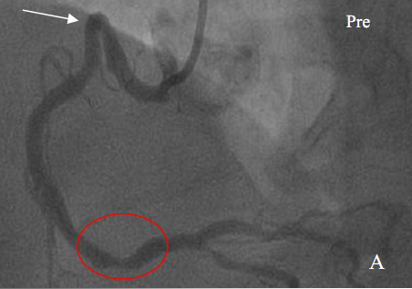
Shepherd’s-crook RCA
~5%
Acute superiorly angled take-off of the RCA from the aorta.
Difficult RCA lesion angioplasty
Ethan Halpern. Cardiac CT . Functional anatomy.

Slide 26
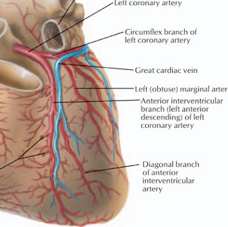
Left coronary artery
LMCA
10-15mm(upto 30mm) length & 3-6mm(upto 10mm diameter),diameter is inversely proportional to its length,
Trifurcates in 1/3rd : Ramus intermedius/ median artery/straight LV artery/left diagonal artery.

Slide 27
LMCA
Largest and shortest coronary artery
Ostium of LCA 1cm higher than that of RCA
Axis of ostium is 30-40* posterior to frontal plane
Vessel is directed anteriorly,left and downward between the pulmonary trunk and left atrium.
Ostium is thus located posterior to axis of artery.
Hence catheterization is best in LAO 30*but course of artery is best outlined in shallow view.

Slide 28
LMCA –area perfused
Entire LV,LA except the posterior portion of IVS and adjacent area when PDA is branch of RCA

Slide 29
LMCA variations
When LM is absent the coronary ostium appears like shallow funnel with two separate openings.
When LM is short visualization may be difficult
and catheter tip appears to be in direct contact with bifurcation.
In patients with high diaphragm with horizontal hearts a weeping willow view LAO 60* cranial 30* may improve visualisation of LM and its branches.

Slide 30
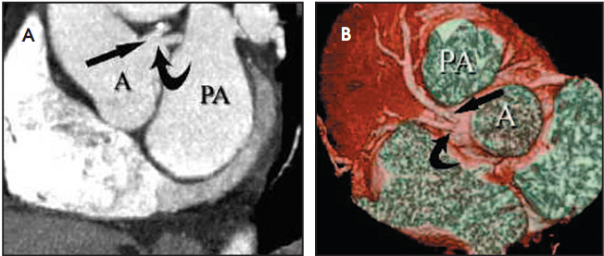
Absent LMCA
Topaz et al. Absent left main coronary artery: angiographic findings in 83 patients with separate ostia of the left anterior descending and circumflex arteries at the left aortic sinus.
Am Heart J.1991 Aug;122(2):447-52.

Slide 31
LAD –angiographic classification
By D.B.Effler(personal communication)
Based on length and amount of myocardium it perfuses
Type 1-small caliber vessel reaches only 2/3rd of way from base of heart to apex,more prevalent in women
Type 2-larger caliber reaches the apex of LV
Type 3-extends from base to apex wraps around the diaphragmatic surface of LV where it augments the perfusion pattern of PDA.

Slide 32
LAD
For practical purposes is a continuation of the LMCA
Passes to the left of pulmonary trunk and travels into the upper portion of IV sulcus.
As it turns around the pulmonary artery and begins its downward course the LAD forms a 90* angle often highlighted by origin of 2nd diagonal .
Surgical importance of this location is that it is the point where LAD is amenable to bypass.

Slide 33
LAD-branches
1) Diagonals
In most cases 1st branch of LAD is 1st diagonal branch
Arises close to bifurcation of LM
2-9 in number
Supplies whole of LV free wall

Slide 34
LAD-branches..
2) Septals
vary in number
Arise in about 90* angle
Runs along septum from front to back and in caudal direction
The anterior septal perforators mechanically immobilize the LAD, fixing it to the heart,limiting its motion,and preventing buckling of the artery during systole .

Slide 35
SEPTALS-territory supplied
2/3rds of upper portion of septum and almost entire septum in inferior 3rd.
When PDA arises from LCX the LCA is the sole source of supply for entire IVS.

Slide 36
SEPTALS-ANGIOGRAPHIC CHARACTERISTICS
More cranial septal branches are better demonstrated than lower septal branches because of greater length and caliber
Characteristic branching of 90*from LAD and straight course,lacking slight tortuosity of other branches
Another characteristic feature is relative lack of motion(evident when LCA is viewed against the background of LCX in RAO view)

Slide 37
LAD-branches…
3) RV branches
gives 1 or more branches to the right ventricle.
Highest of these rise to the level of pulmonary valve forming vieussen s anastomosis.
The other branches run obliquely over the RV surface anastomosing with similar branches of the RCA.
Form importanat cllateral channel.

Slide 38
4) Terminal branches of LAD type 3
Apical branches
Usually 2 branches can be seen
Recurrent posterior-supplies diaphragmatic portion
Recurrent lateral-supplies lateral aspect of apex.
Referred to as pitch fork, mustache or whale’s tail

Slide 39
Myocardial bridging
short segments of the LAD can travel within the myocardium (covered by a so-called myocardial bridge) resulting systolic luminal narrowing is probably benign in the vast majority of people.
0.5 to 1.6% in general population,28% in children,30-50% in HOCM.
associated with a poor prognosis (higher incidence of myocardial ischemia and sudden death) in patients with hypertrophic cardiomyopathy

Slide 40
Surgical division of the LAD
Proximal - Ostium to 1st major septal perforator or 1st diagonal artery whichever is first
Mid - 1st perforator to D2 (90 degree angle)
Distal - D2 to end

Slide 41
Left circumflex artery
Departs at a sharp angle from LM to run posteriorly along the AV groove towards the crux cordis.
Reaches crux only in 16% cases
Course nearly mirrors that of RCA.
Notes:
LCx supplies 15-25% of LV (40-50% in dominant LV)

Slide 42
LCX-branches
Soon after origin divides into 2 parallel branches
Lower and larger gives origin to ventricular branch
Upper gives atrial circumflex to atrial wall
Largest and constant branch is obtuse marginal
Runs along the ventricular wall posteriorly and in direction of apex

Slide 43
The proximal portion of the obtuse marginal,LAD and diagonal branches may be closely superimposed on one another when the origin of the obtuse marginal is along the initial segment of the circumflex
Bunching up of branches,difficult to recognize minor lesions in RAO and LAO view
RAO 30*cranial 20* may be necessary.

Slide 44
LCX-branches
After the obtuse marginal the LCX travels all way around the left AV groove and gives rise to posterolateral branches.
Because of its close relation to the AV groove (and mitral valve ring) this portion of artery moves widely with systole (towards apex) and diastole(away from apex).
Reaches crux and enters the posterior IV groove as PDA .Regardless of origin PDA follows same course in posterior IV groove.
Its origin from circumflex is best seen in LAO view.

Slide 45
LCX-territory supplied
Supplies lateral wall of LV above the diaphragmatic surface

Slide 46
Surgical division of the LCX
Proximal - Ostium to 1st major obtuse marginal branch
Mid - OM1 to OM2
Distal - OM2 to end

Slide 47
Optimal angiographic views for coronary segments
Carlo Di Mario, Nilesh Sutaria. CORONARY ANGIOGRAPHY IN THE ANGIOPLASTY ERA: PROJECTIONS WITH A MEANING Heart 2005;91:968–976.

Slide 48
RAO- RCA

Slide 49
Optimal angiographic views for coronary segments
Carlo Di Mario, Nilesh Sutaria. CORONARY ANGIOGRAPHY IN THE ANGIOPLASTY ERA: PROJECTIONS WITH A MEANING Heart 2005;91:968–976.

Slide 50
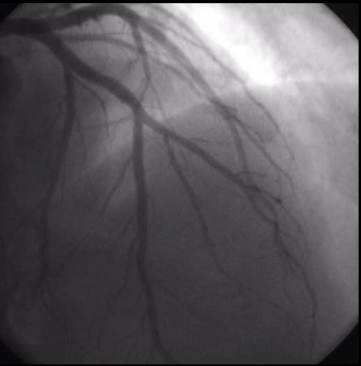
PA 5-10* cranial 35-45*- LCA

Slide 51
PA Cranial view -RCA

Slide 52
RAO cranial - RCA

Slide 53
Optimal angiographic views for coronary segments
Carlo Di Mario, Nilesh Sutaria.CORONARY ANGIOGRAPHY IN THE ANGIOPLASTY ERA: PROJECTIONS WITH A MEANING Heart 2005;91:968–976.

Slide 54
RAO 30-45* caudal 30-40* - LCA

Slide 55
Optimal angiographic views for coronary segments
Carlo Di Mario, Nilesh Sutaria.CORONARY ANGIOGRAPHY IN THE ANGIOPLASTY ERA: PROJECTIONS WITH A MEANING Heart 2005;91:968–976.

Slide 56
AP 5-10* caudal 25-35*- LCA

Slide 57
Optimal angiographic views for coronary segments
Carlo Di Mario, Nilesh Sutaria. CORONARY ANGIOGRAPHY IN THE ANGIOPLASTY ERA: PROJECTIONS WITH A MEANING Heart 2005;91:968–976.

Slide 58
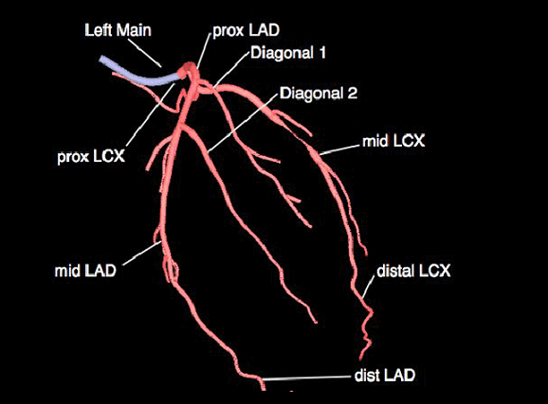
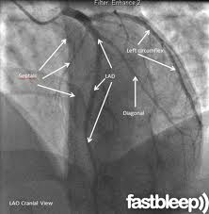
LAO 30-45* cranial 25-35*- LCA
Notes:
Some overlap with LCX can be overcome by more 60 degree LAO tilt.
However when the proximal LCA is superiorly directed it is not an optimal view- use LAO caudal

Slide 59
LAO cranial-RCA

Slide 60
Optimal angiographic views for coronary segments
Carlo Di Mario, Nilesh Sutaria.CORONARY ANGIOGRAPHY IN THE ANGIOPLASTY ERA: PROJECTIONS WITH A MEANING Heart 2005;91:968–976.

Slide 61
LAO 40-50* caudal 25-40* (Spider view) - LCA
Notes:
Enhanced by maximal expiration as the heart becomes more horizontal

Slide 62
Coronary segment classification system
CASS investigators – 27 segments
BARI – 29 segments ( ramus intermedius and 3rd diagonal branch)

Slide 65
Thank you

Slide 66
SYNTAX SCORE
An angiographic tool grading the complexity of coronary artery disease
A semiquantitative visual score that will help us to be aware of the anatomical complexity and to anticipate procedural difficulties

Slide 69
One drawback in these comparisons is that there is heterogencity in the complexity of CAD of the patients enrolled.
Absence of grading of severity of CAD and lack of comparison of lesion complexity between various groups severely limits the interpretation of results.

Slide 70
For example pts with distal LM trifurcation disease with occluded RCA is pooled together as TVD with patients with 3 focal lesions in midportion of the 3 coronary arteries.
The first has a greater therapeutic challenge for PCI and both have completely different prognosis regardless of revascularisation.

Slide 71
SYNTAX (Synergy between PCI with TAXUS stent and cardiac surgery) trial was organised for patients with significant lesion in LM and /or TVD.
The syntax score has been used in this study to categorize the coronary vasculature with respect to the number of lesions their functional impact,location and complexity.

Slide 72
The SYNTAX score has been developed based on the following:
1. The AHA classification of the coronary tree segments modified for the ARTS study
2. The Leaman score
3. The ACC/AHA lesions classification system
4. The total occlusion classification system
5. The Duke and ICPS classification systems for bifurcation lesions
6. Consultation of experts

Slide 73
AHA Definition of coronary tree segments
Arterial tree is divided into 16 segments
This system has been adopted for the syntax scoring.

Slide 76
LEAMAN SCORE
Based on severity of luminal diameter narrowing
Weighed according to usual blood flow to LV by each vessel

Slide 77
Severity of luminal diameter narrowing
significant lesion-50% reduction in lumen diameter by visual assessment in vessels >1.5mm in diameter.
Less severe lesions not included
Percent diameter stenosis is not included
Only occlusive lesions (100% stenosis)-MF 5
And non occlusive lesions (50-99% stenosis)-MF 2

Slide 79
In right dominant system
-RCA supplies 16%
-LCA supplies 84% of flow to LV
Of the 84%,66% is by LAD and 33% by LCX.
The LM supplies approximately 5 times,the LAD app.3.5 times and LCX app.1.5 times blood as the RCA to the LV.

Slide 80
For left dominant system
-LM supplies 100%(hence multiplication factor 6)
-LAD 58% (MF-3.5)
-LCX 42% (MF-2.5)
The contribution is used as a multiplication factor
-

Slide 82
ACC/AHA lesion classification system
Type A (high success ,low risk)
Type B (mod success ,mod risk)
Type C (low success ,high risk)

Slide 84
Total occlusion classification system
No antegrade flow is visible distal to lesion
Distal segments may be filled via bridging ,ipsilateral or contralateral collaterals.
Parameters included are
-Age of occlusion
-blunt stump
-presence of bridging collaterals
-presence of side branch
-occlusion length

Slide 85
DUKE and ICPS bifurcation lesion classification
Defined as junction of main vessel and a side branch (1.5mm)
Not involving ostium(A,B,C)
Involving ostium(D,E,F,G)

Slide 86
DUKE and ICPS bifurcation lesion classification

Slide 87
Bifurcation segments
5/6/11
6/7/9
7/8/10
11/13/12a
13/14/14a
3/4/16
13/14/15

Slide 88
Trifurcation segments
3/4/16/16a
5/6/11/12
11/12a/12b/13
6/7/9/9a
7/8/10/10a

Slide 91
SCORING method
Started from RCA to qualify the dominance
Visually score each lesion starting from RCA
Only lesions >= 50% in a vessel >=1.5mm in diameter should be scored
Tandem lesions should be considered as single lesion
Points calculated for each lesion and then added together.

Slide 92
LIMITATION
Does not entail any clinical variable
Comorbidities are known to impact early outcomes of patients undergoing revascularisation.
Hence limited use in guiding decision making between CABG and PCI.
Relies on pure visual interpretation of lesion severity and subjective variables hence poor reproducibility.

Slide 93
Functional syntax score
Incorporates ischemia producing lesions as determined by FFR.

Slide 94
Clinical syntax score
Syntax score +
Age
Creatinine
EF

Slide 95
SYNTAX score II
Anatomical syntax score
Age
Creatinine clearance
LVEF
ULMCA
Peripheral Vascular Disease
Female sex
COPD

Slide 96
Aids in decision making between CABG and PCI
Interaction for particular baseline characteristic was defined by the hazard ratio.
Hazard ratio is defined as HR of mortality of that characteristic undergoing PCI to the HR of mortality in those undergoing CABG.

Slide 97
EURO SCORE-European System for cardiac operative risk evaluation

Slide 100
MACCE to 5 years by Syntax Score Tercile
Left Main Disease
PCI or CABG
PCI or CABG
CABG

Slide 101
Thank You

Slide 102
References
Hurst’s The Heart 13th Edition
Braunwalds Heart Disease 2nd edition
Grey’s Anatomy
Kern’s Handbook of Interventional Catheterization
Grossman’s Textbook of Cardiac Catheterization
Carlo Di Mario, Nilesh Sutaria. CORONARY ANGIOGRAPHY IN THE ANGIOPLASTY ERA: PROJECTIONS WITH A MEANING Heart 2005;91:968–976
David M Fiss. Normal coronary anatomy and anatomic variations. Applied Radiology, Jan 2007.
Horia Muresian. Coronary arterial anomalies and variations. MAEDICA. A journal of clinical Medicine,1(1), 2006.

